Slide 1
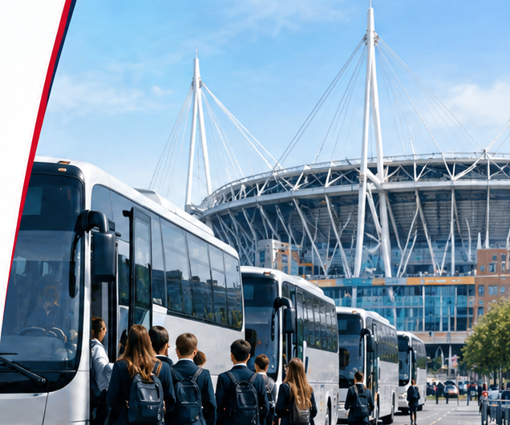

AI POLLINATION STUDENT COMPETITION 2026
Campus Cruise
AI-powered school transport optimisation for events in Wales
Dhanush Kalapati · Samyaka Nadavala · Sathwika Orugonda
Cardiff University · Technical Challenge 2: Travel Organizer
Notes:
TIME: 0:00-0:20 (20 s)
SAY:
We're Dhanush Kalapati, Samyaka Nadavala and Sathwika Orugonda from Cardiff University. This is Campus Cruise: it decides which schools should share a bus to an event, so getting pupils there costs less, and it proves every plan keeps the rules.
KEY MESSAGE: Campus Cruise plans shared school buses to an event.

Slide 2










The Challenge of
School Transport Planning
PROBLEM STATEMENT
60 schools are sending 1,244 people to one event. Getting them there efficiently is a hard planning problem.
High transport costs
Empty seats
Every school booking its own bus means 60 buses and 3,330 cost units.
Booked separately, only 68.0% of seats are filled; the rest are paid for and empty.
Groups stay together
Too many choices
Each school's group is supervised by its own adult, so it can never be split across buses.
Sizes, locations, 15/35/50-seat buses and prices: far too many groupings to check by hand.
›
›
Event venue
The problem we are solving: how can schools share buses, never split a group or overfill a bus, and pay as little as possible?
Notes:
TIME: 0:20-0:55 (35 s)
SAY:
Sixty schools are sending 1,244 people to the same stadium. If every school books its own bus, that's 60 buses, and only 68.0% of the seats are filled. Sharing is obviously cheaper, but schools differ in size and location, buses come in three sizes, and there are far too many groupings to check by hand. And each school's group must stay together on one bus, because one adult supervises it.
KEY MESSAGE: Booking separately wastes seats and money; sharing is too complex to plan by hand.

Slide 3



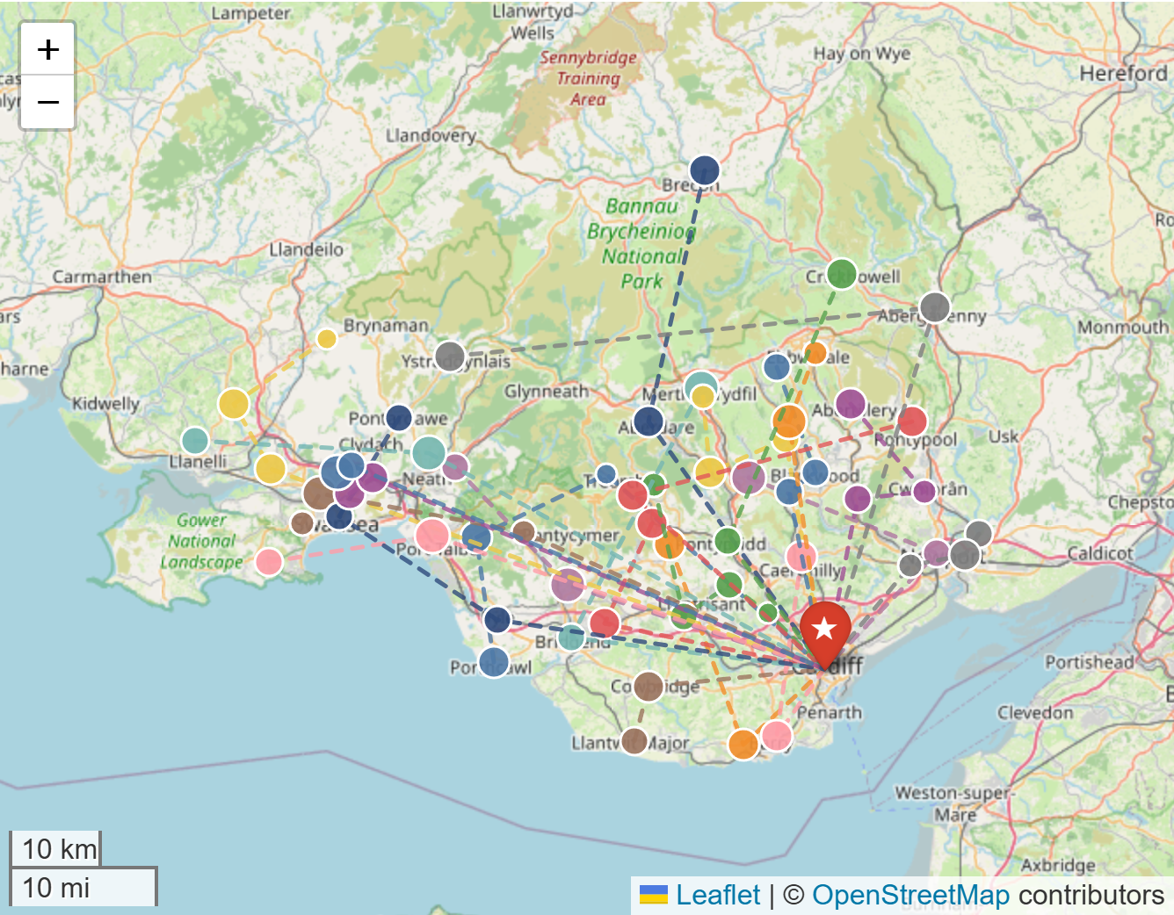











Campus Cruise
PROPOSED SOLUTION
Plans shared school buses to any event: picks which schools share each bus and the pickup order, then checks every rule before anyone sees the plan.
1
Input data
2
Optimise
3
Validate
4
Visualise
5
Export
Schools and venue
Choose the cost model
Independent re-check
Dashboard and map
Share and book
School CSV upload, checked row by row
Fixed price per bus
Every school allocated
Plan CSV: bus, pickup order, cost share
Attendees per school
›
›
No school split
›
›
Report and audit report
Price per mile
No bus over capacity
Bus sizes and prices
Clear pickup order per bus
Price per driving hour
Every attendee seated
25 buses, one colour each; star = venue
Venue: search any address
Costs recalculated
Ready for booking
Our goal: the cheapest plan that keeps every rule, for any schools and any venue.
Lower cost
Fuller buses
Fewer miles
Plan in seconds
Notes:
TIME: 0:55-1:25 (30 s)
SAY:
Campus Cruise works in five steps. Load the schools: the bundled data, or upload any school CSV, and search any venue by address. Pick how buses are priced. OR-Tools decides which schools share each bus and the pickup order. Then separate code re-checks every rule and recalculates every cost; a plan that fails is never shown. Finally the plan goes to a dashboard and map, and can be downloaded for booking.
KEY MESSAGE: Every plan is optimised, then independently checked, before anyone sees it, for any schools and any venue.

Slide 4
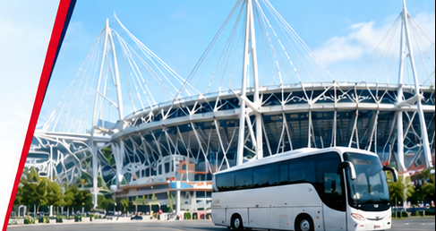

Optimisation Models and AI Approach
ALGORITHMS AND AI APPROACH
One general engine, three pricing rules: no retraining for new schools or venues.
1
Fixed Cost Model
2
Distance Model
3
Travel-time Model
Minimise total bus rental price
Minimise rate × miles
Minimise rate × driving hours
OR-Tools CP-SAT constraint solver
Exact bin packing: chooses bus sizes and groups
Location does not change the price
Can prove no cheaper plan exists
OR-Tools vehicle routing
Cheapest-arc start + guided local search
Orders the pickups on each bus
Miles are straight-line (haversine)
Same routing search
OSRM road driving times, cached
If OSRM is unavailable: labelled estimate
No live traffic or boarding time
1,875
Proven optimal
2,787
Best found in 300 s
6,763
Best found in 300 s
vs 3,330 booked separately
vs 3,904 booked separately
vs 8,220 booked separately
Notes:
TIME: 1:25-2:10 (45 s)
SAY:
The challenge prices buses three ways. With a fixed price per bus, location doesn't matter, so it's a packing problem: OR-Tools' CP-SAT solver finds the cheapest plan and proves nothing cheaper exists. When price depends on miles or driving time, pickup order matters, so we use vehicle-routing search. It finds very good plans, but we never call them optimal. The rules are hard in every model. This is optimisation, not a trained model, so it works for any schools and any venue without retraining. Generative AI is a separate assistant, and the machine-learning model is an experimental offline fallback.
KEY MESSAGE: Exact optimisation where it can be proven; honest 'best found' labels where it cannot.

Slide 5


Significant Improvements in
Transport Efficiency
RESULTS AND PERFORMANCE
Fixed-price plan on the challenge data: fewer, fuller buses, every school kept together.
Total transport cost
Number of buses
Attendees
Seats filled
↓ 43.7%
60 → 25
1,244
99.5%
3,330 → 1,875 cost units
58.3% fewer buses
all seated, from 60 schools
was 68.0% booked separately
Metric | Separate | Campus Cruise | Change
Total cost | 3,330 | 1,875 | −43.7%
Buses | 60 | 25 | −35
Seats filled | 68.0% | 99.5% | +31.5 pp
Cost per attendee | 2.68 | 1.51 | −44%
Bus-miles (straight line) | 1,289.4 | 789.4 | −38.8%
Other models (best found in 300 s): per mile −28.6%, per driving hour −17.7%. Challenge data only.
Notes:
TIME: 2:10-2:45 (35 s)
SAY:
With a fixed price per bus, the plan costs 1,875 instead of 3,330: 43.7% less, with 25 buses instead of 60, and 99.5% of seats filled. That is provably the cheapest. Bus-miles drop 38.8%. The other two models save 28.6% and 17.7%; those are the best plans found in five minutes. These are cost units, not pounds.
KEY MESSAGE: 43.7% cheaper and 35 fewer buses, proven optimal for fixed pricing.

Slide 6

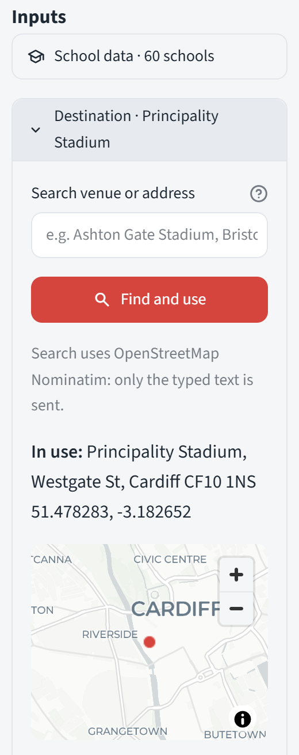




Campus Cruise in Action
APPLICATION AND KEY FEATURES
A working web application to plan, optimise and check shared school transport for any event.
Inputs
Optimised route map
Upload school data
Real screenshots, 28 Oct 2026
Any CSV; bad rows rejected by row number
Search any venue
Type an address; coordinates fill in
Choose the objective
Fixed price, per mile or per hour
Interactive route map
Every bus, its schools and road path
Results and export
Plan CSV, report and audit report
Notes:
TIME: 2:45-4:05 (80 s, live)
SAY:
[Switch to the app at http://localhost:8501]
1. (15 s) Sidebar: Fixed price per bus, Run optimiser. Point at 'Proven optimal', 25 buses, 1,875 vs 3,330.
2. (20 s) Routes tab: Find a school, CF15, turn on Road paths. 'Bus 04 picks up four schools and is completely full, 50 of 50. The line is the real road route from OSRM.' Read the note: estimates exclude live traffic and boarding time.
3. (25 s) Destination: type 'Wembley Stadium', Find and use. 'Any venue: the coordinates fill in, the map moves, and every cost and route now goes there.' Run again, show routes ending at Wembley. Then Reset to Principality Stadium.
4. (20 s) School data: 'Organisers can upload their own schools as a CSV; a bad row is rejected with its row number, never silently dropped.'
If the demo fails: stay on this slide and talk through the screenshots.
KEY MESSAGE: It's a working app for any schools and any venue, with honest estimates.

Slide 7
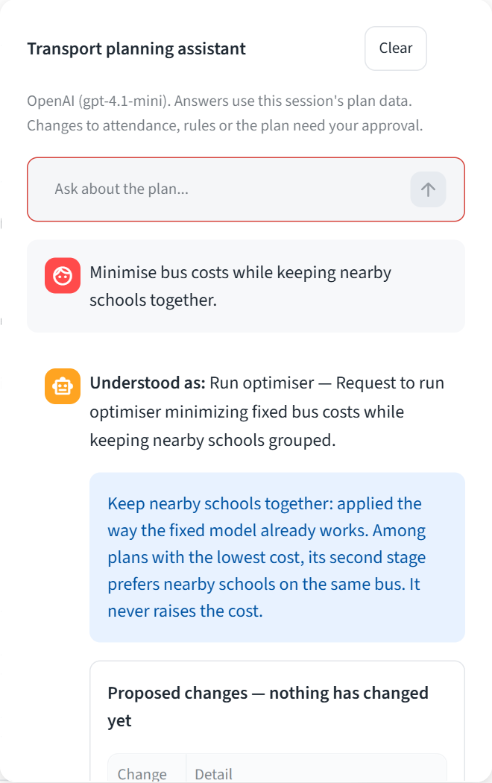





AI Assistant: You Approve
GENERATIVE AI WITH HUMAN CONTROL
Organisers type what they want in plain English. The assistant cannot change anything on its own.
1
You type a request
"Minimise bus costs while keeping nearby schools together."
2
GPT-4.1 mini proposes
Structured JSON only: no tools, no direct changes
3
Code checks the proposal
Every school, number and rule against the data
4
You approve or reject
Nothing changes until you approve
5
Optimiser and validator run
The same OR-Tools models and checks as every plan
Real screenshot
Notes:
TIME: 4:05-4:40 (35 s)
SAY:
Organisers can also just type: 'Minimise bus costs while keeping nearby schools together.' GPT-4.1 mini turns that into a proposal, but it can't change anything. Code checks it against the data and shows it: nothing has changed yet. Only when I approve does the optimiser run. And it's honest: 'nearby' isn't a hard rule, it's how the fixed model breaks ties, and it says so.
KEY MESSAGE: Generative AI makes the tool easy to use, but people and the optimiser stay in control.

Slide 8





Sector Impact: Who Benefits
IMPACT AND BENEFICIARIES
Measured on the challenge data; the next step is to measure it at a real event.
−35
buses to book and coordinate
Event organisers
Schools and teachers
Pupils
99.5%
seats filled (was 68.0%)
A checked plan in seconds
Lower, fair cost shares
Lower cost to attend
−38.8%
bus-miles, 1,289 → 789 (straight line)
Coach operators
Event venues
Local communities
A clear booking list
Fewer coaches to park
Less coach traffic
Fixed-price plan; baseline = one bus per school. No fuel or emissions claim.
Notes:
TIME: 4:40-5:15 (35 s)
SAY:
Who gains? Organisers get a checked plan in seconds. Schools and pupils pay less to attend. Coach operators get a clear booking list, and venues have fewer coaches to park. On the challenge data that's 35 fewer buses, 99.5% of seats filled, and about 39% fewer bus-miles, straight-line, with no emissions claim. And because it takes any schools and any venue, it isn't tied to one stadium.
KEY MESSAGE: Measurable savings on the data, and a clear plan to prove them in the real world.

Slide 9






Responsible AI by Design
RESPONSIBLE AI
Decision support, not an autonomous system: people approve, code verifies.
Transparency
Privacy
Security
Every plan labelled proven optimal or best found; estimates marked
School-level head counts only, no pupil names; address search sends only the typed text
API keys never shown or logged; the LLM has no tools
Accountability
Safety and fairness
Honest limits
Organiser approves every AI change; audit report of every run
Rules re-checked by independent code; cost shared per attendee
No live traffic or boarding time; not yet tested at a real event
Notes:
TIME: 5:15-5:50 (35 s)
SAY:
Campus Cruise is decision support, not an autonomous system. Every plan says whether it's proven or just the best found. It uses school-level head counts only, no names, and the address search sends only the typed text. API keys are never shown, and the language model has no tools. The organiser approves every AI change, every run is in an audit report, and independent code re-checks every rule. And we are honest about limits: no live traffic or boarding time, and it has not yet run at a real event.
KEY MESSAGE: Responsible by design: people approve, code verifies.

Slide 10
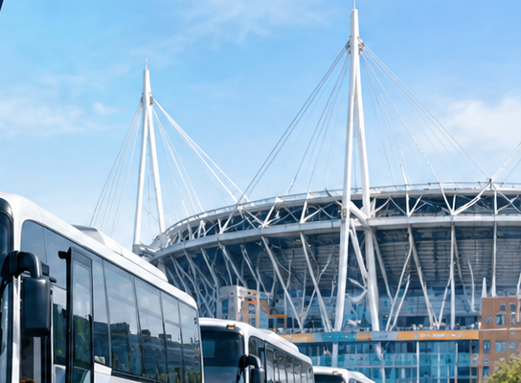




CONCLUSION
Fewer buses, lower cost,
plans people can trust
Problem
Result
Contribution
Next step
Schools booking alone waste seats and money
43.7% cheaper, 60 → 25 buses, proven optimal
Exact + routing optimisation, independent checks, any schools and venue
Pilot with a Welsh organiser; collect feedback
Thank you. Questions?
Notes:
TIME: 5:50-6:10 (20 s)
SAY:
Campus Cruise finds which schools should share a bus: 43.7% cheaper on the challenge data, 25 buses instead of 60, proven optimal and independently checked, and it now works for any schools and any venue. Next, we'd like to pilot it with a Welsh event organiser.. Thank you, we're happy to take questions.
KEY MESSAGE: Campus Cruise: fewer buses, lower cost, and plans organisers can trust.

